Slide 1

SALES DATA REPORT

Slide 2

Welcome to the presentation on our sales dataset, which provides valuable insights into the business performance. This dataset captures critical information about transactions, including customer demographics, product offerings, pricing, and financial metrics. By analyzing these elements, we aim to identify trends, assess branch performance, understand customer preferences, and enhance overall sales strategies. Let's explore the data to uncover actionable insights that can drive growth and improve customer satisfaction.
INTRODUCTION

Slide 3
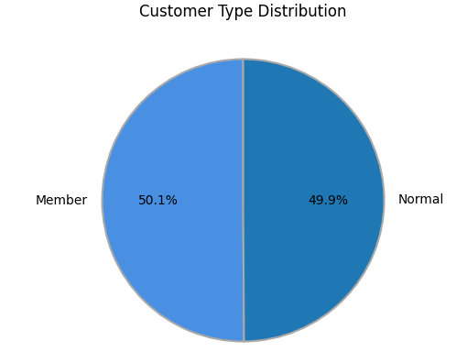
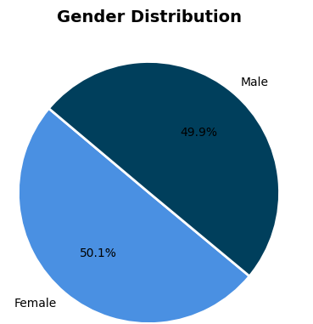
DATA DISTRIBUTIONS
Gender Distribution: The gender distribution is nearly balanced, with males representing 49.9% and females at 50.1%. This indicates a slight female majority in the dataset, suggesting that both genders are well-represented, which may be beneficial for analyzing gender-specific trends in customer behavior.
Customer Type Distribution: The customer type distribution is also almost equal, with 50.1% of customers classified as "Members" and 49.9% as "Normal" customers. This equilibrium reflects a diverse customer base, highlighting the importance of catering to both member and non-member segments in marketing strategies and service offerings.

Slide 4
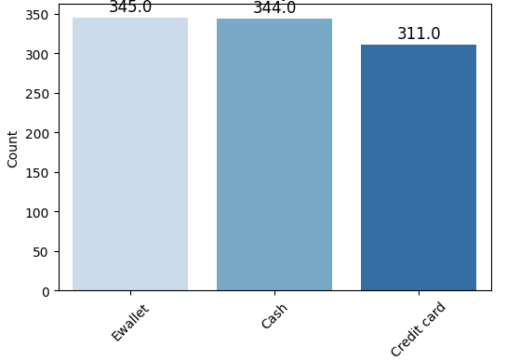
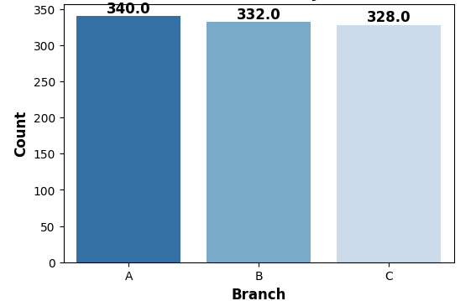
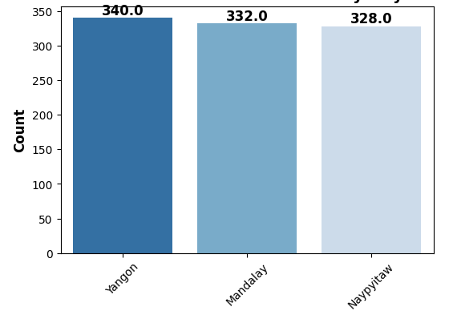
Distribution of Payment Method
Distribution by Branch
Distribution by City
Distribution of Payment Method: The chart indicates that Ewallet is the most popular payment method, with a total of 345 counts, while other methods have slightly fewer.Distribution by payment: All branches (A, B, and C) show similar counts, with Branch A slightly leading at 340 counts, indicating balanced performance across branches.Distribution by Branch: The city distribution reveals Yangos at 340 counts, indicating a higher distribution of sales in that city

Slide 5
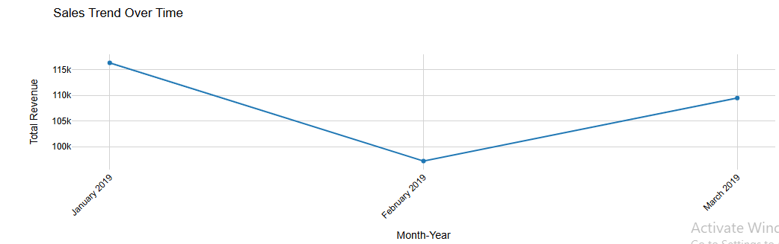
The line chart depicts sales trends over time, showing fluctuations in total revenue. Notably, there’s a peak in January 2019, a decline in February 2019, followed by a recovery in March 2019, indicating seasonal variations in sales performance.
RELATIONSHIP BETWEEN DATA VARIABLES

Slide 6
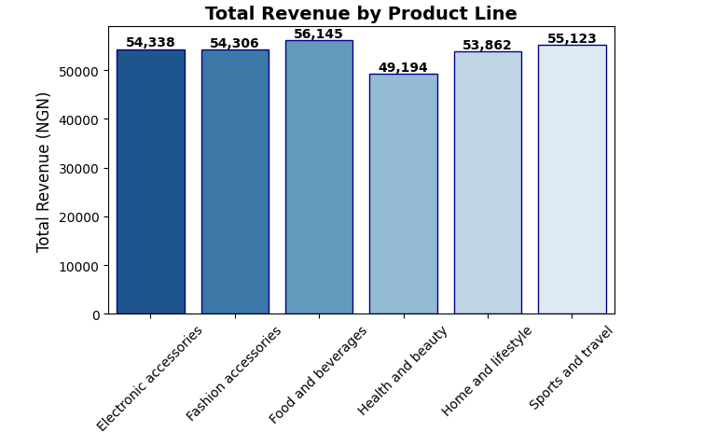
TOTAL REVENUE BY PRODUCT LINE
The bar chart highlights total revenue across product lines, with "Food and Beverages" generating the highest revenue at NGN 56,145, followed closely by "Sports and Travel" at NGN 55,123. “Health and beauty" has the lowest revenue at NGN 49,194.

Slide 7
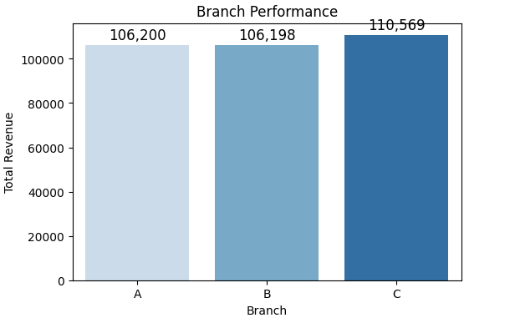
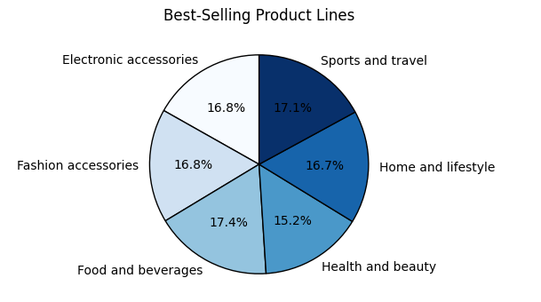
The bar chart shows branch performance, with Branch C leading at 110,569 NGN in total revenue, followed closely by Branch A and B. The pie chart highlights the best-selling product lines, Food and beverages at 17.4% and sport and travel at 17.1%, indicating strong customer preference in these categories.
Recommendation: Recommendation: Analyze Branch C’s successful strategies and replicate them in underperforming branches. This could include staff training, marketing efforts, or product offerings.

Slide 8
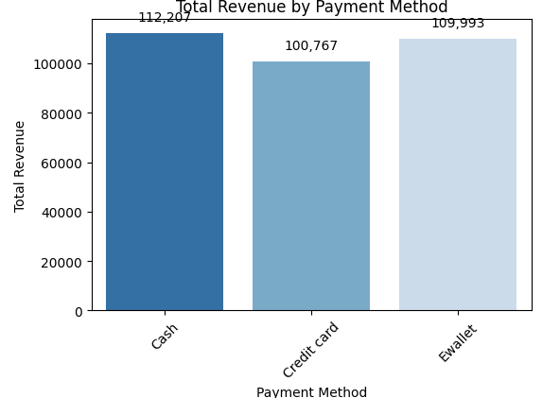
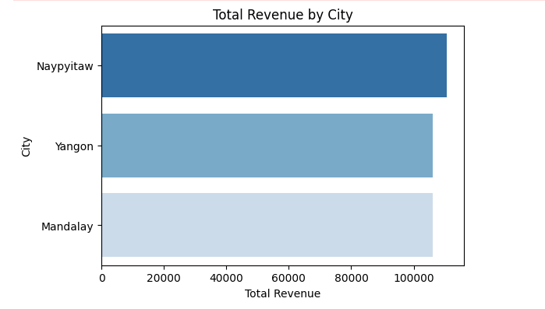
The adjacent chart illustrates total revenue by city, with Naypyitaw leading at 112,000 NGN, followed by Yangon and Mandalay. The bar chart shows total revenue by payment method, highlighting cash as the most preferred option at 112,207 NGN, followed by Ewallet and credit card transactions. Recommendation:
Recommendation: Since cash has the highest payment method, they should consider promoting digital payment options through incentives or discounts to reduce cash handling and improve transaction efficiency.
Develop targeted marketing campaigns for Mandalay and Yangon to boost customer engagement and satisfaction. Consider local events or promotions tailored to its demographics.

Slide 9
AVERAGE RATINGS FOR CITY
7.07
7.02
6.81
NAYPYITAW
YANGON
MANDALAY
110,568
106,200
106,197
REVENUE
This shows city ratings, with Naypyitaw receiving the highest rating at 7.07, followed closely by Yangon at 7.02. Mandalay has the lowest rating at 6.81, indicating varying levels of customer satisfaction across these cities. Naypyitaw: Rated at 7.07, with a revenue of 110,568 NGN.Yangon: Rated at 7.02, with a revenue of 106,200 NGN.Mandalay: Rated at 6.81, with a revenue of 106,197 NGN.This indicates that Naypyitaw has the highest rating and revenue, while Mandalay has the lowest rating but similar revenue to Yangon. The differences in ratings and revenue provide insights into customer satisfaction and financial performance across these cities.

Slide 10
Slide 11
THANK YOU

